Slide 1
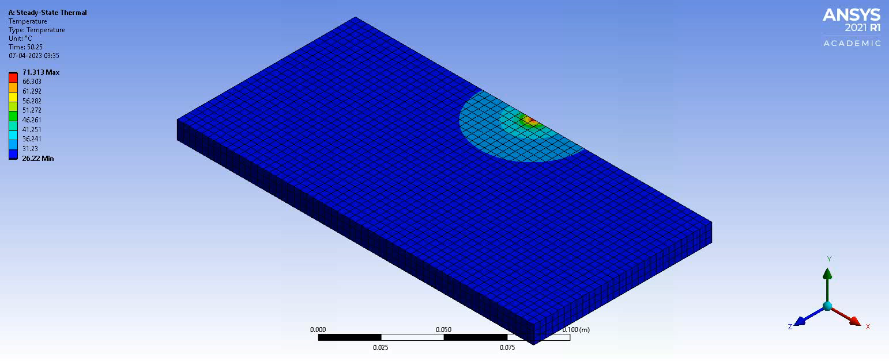
Simulation result for Power Density = 10e6

Slide 2
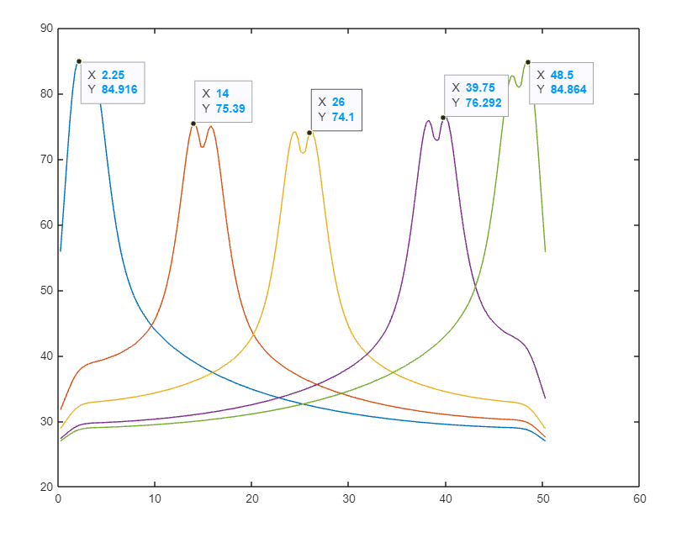
Variation in longitudinal direction for
Power Density = 10e6

Slide 3
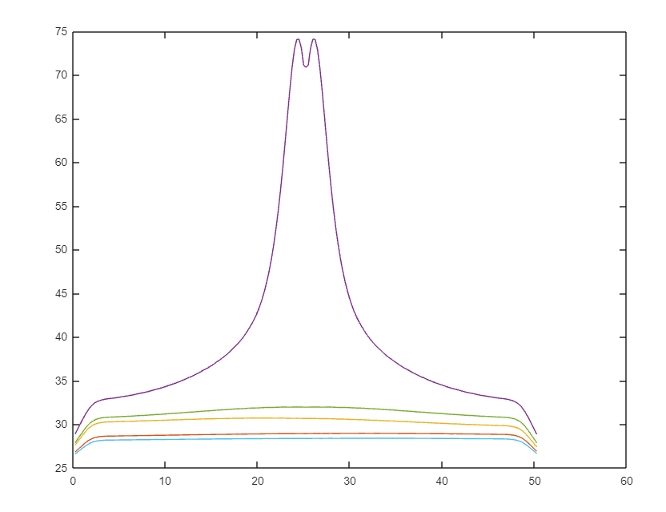
Variation in Transverse direction for
Power Density = 10e6

Slide 4
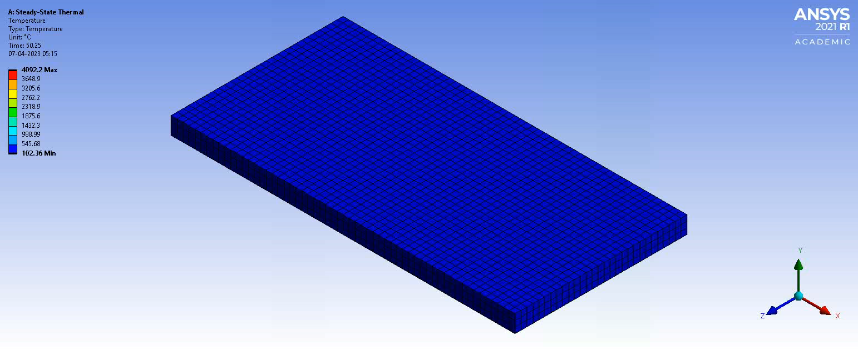
Simulation result for Power Density = 10e8

Slide 5
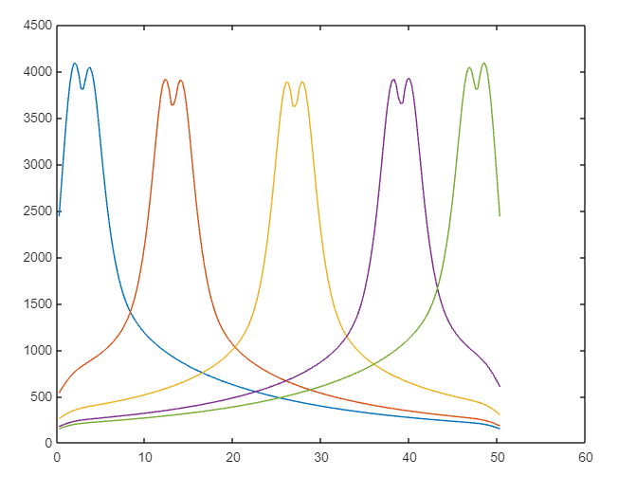
Variation in longitudinal direction for
Power Density = 10e8

Slide 6
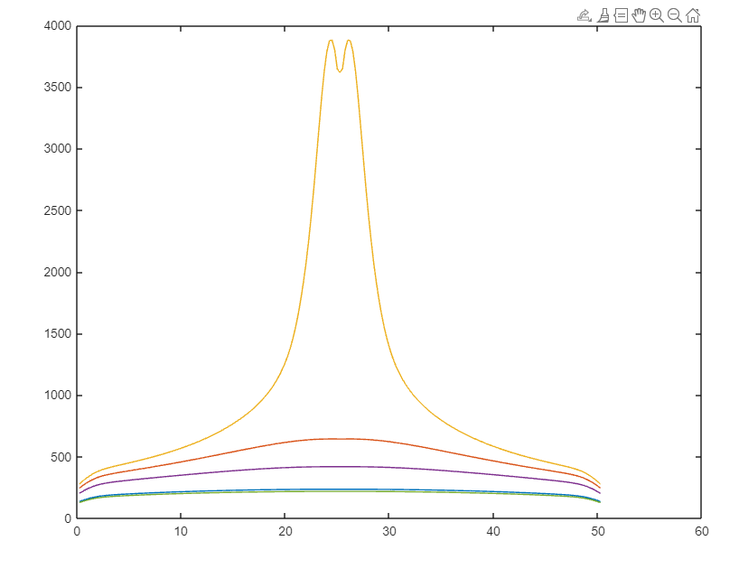
Variation in direction for
Power Density = 10e8

